Slide 1

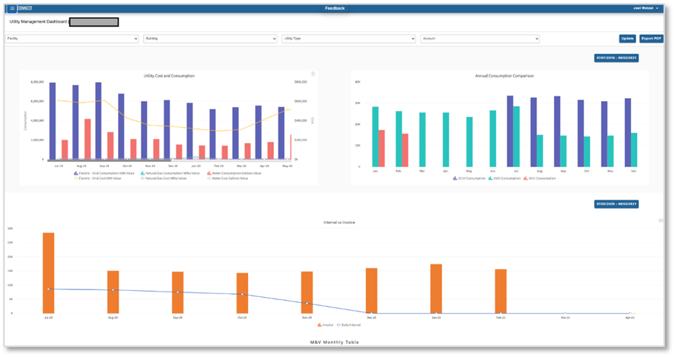
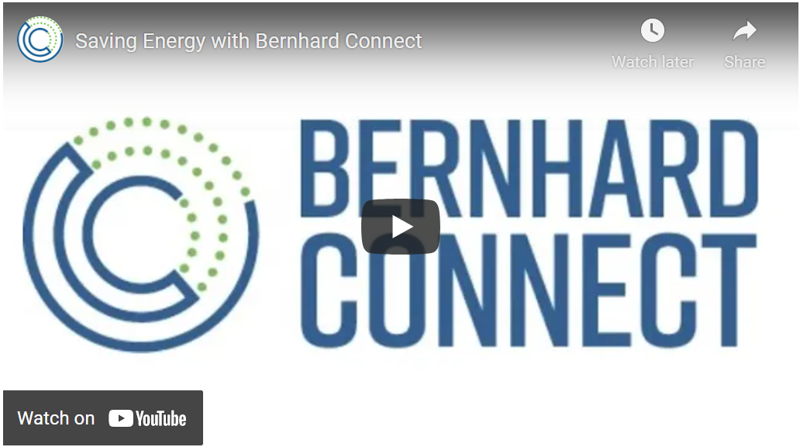
Bernhard Connect - IoT Data & Analysis Platform
Business Need
Bernhard hired Affirma to architect and implement an IOT solution for HVAC systems to enable their customers to both reduce costs and meet energy efficiency pledges. In order to differentiate themselves in the market as well as satisfy energy efficiency demands of their customers, Bernhard needed custom software built to collect, analyze and display energy usage data.
What We Did
After we scoped the required specifications of this tool, Affirma’s 25-person team created multiple workstreams to ensure that:
Hardware was configured to meet all requirements
User interface (UI) was intuitive and easy to access
Tool captures data, transmits it to the cloud, and makes it consumable for Bernhard consultants
Results
Bernhard began using the custom build product with great success on significant projects, and the tool is now commercially viable and a fully usable product.

Slide 2
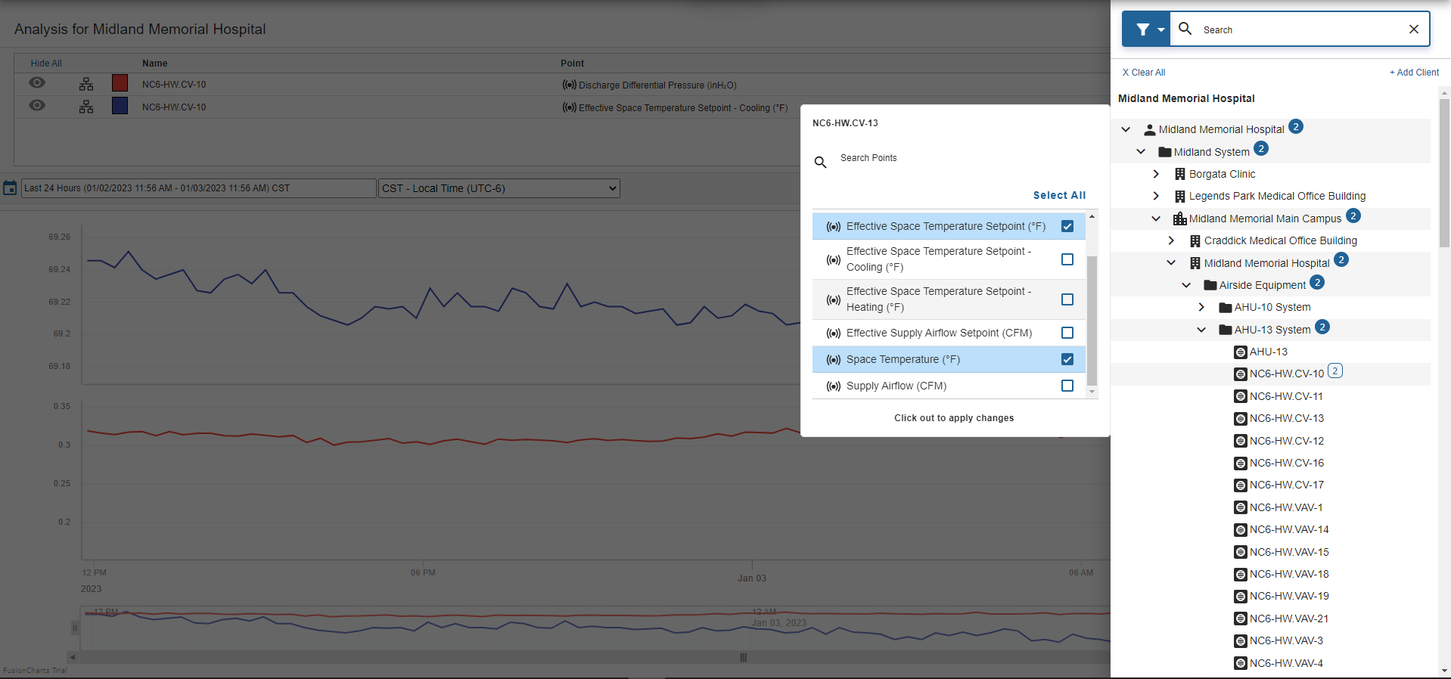
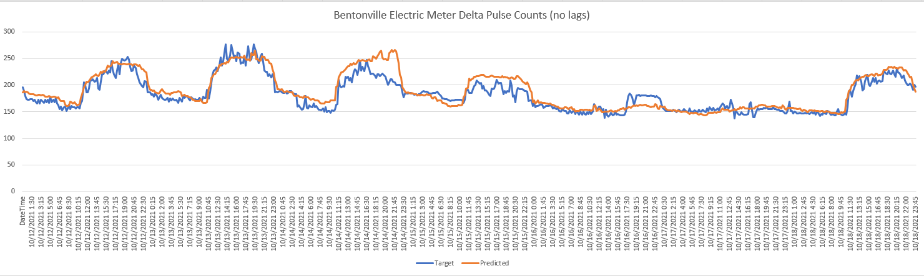
Bernhard Connect - IoT Data & Analysis Platform
Bentonville Electric Meter Pulse Data Counts
Blue Line: electricity usage from an IoT equipped electric meter
Orange Line: predicted usage from one of Affirma’s Machine Learning models

